Slide 1

Bank Loan Case Study
Email: kbarman1015@gmail.com

Slide 2

Approach
The data set is huge, So to visualize the data set and to get insights from the data set I have used python (jupyter notebook) for EDA of this data. Python libraries like pandas, numpy, seaborn and klib etc.

Slide 3
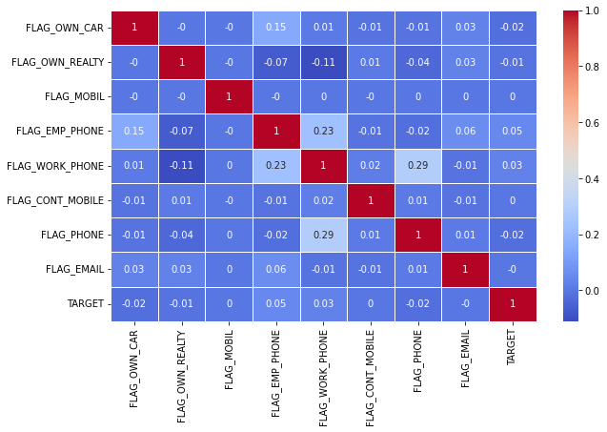
Flag corelation
Flag columns are very less corelated so we can ignore these columns.
I have removed these colums from the data set.

Slide 4
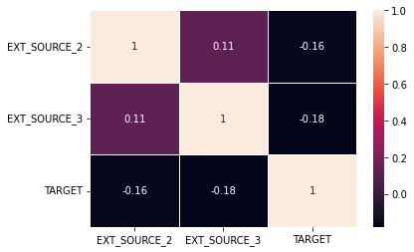
More columns ignored
EXT_SOURCE_2 and EXT_SOURCE_3 are also ignored.

Slide 5
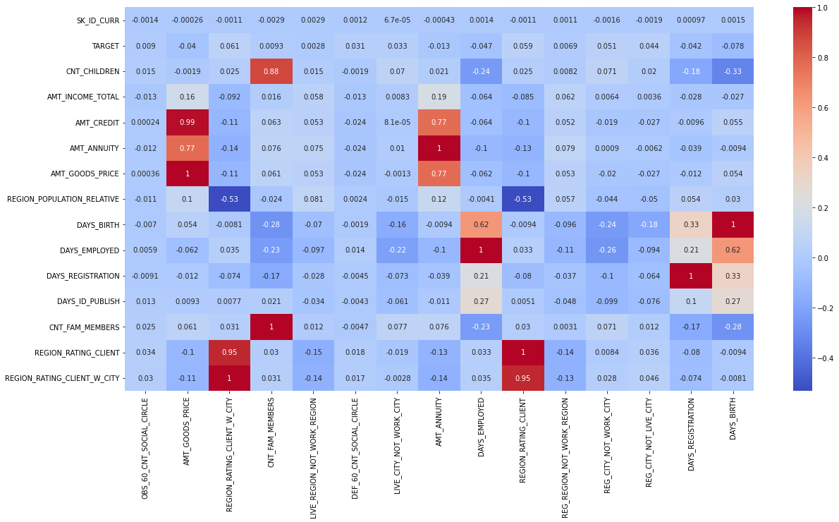
Most corelated numerical columns
For whole Dataset

Slide 6
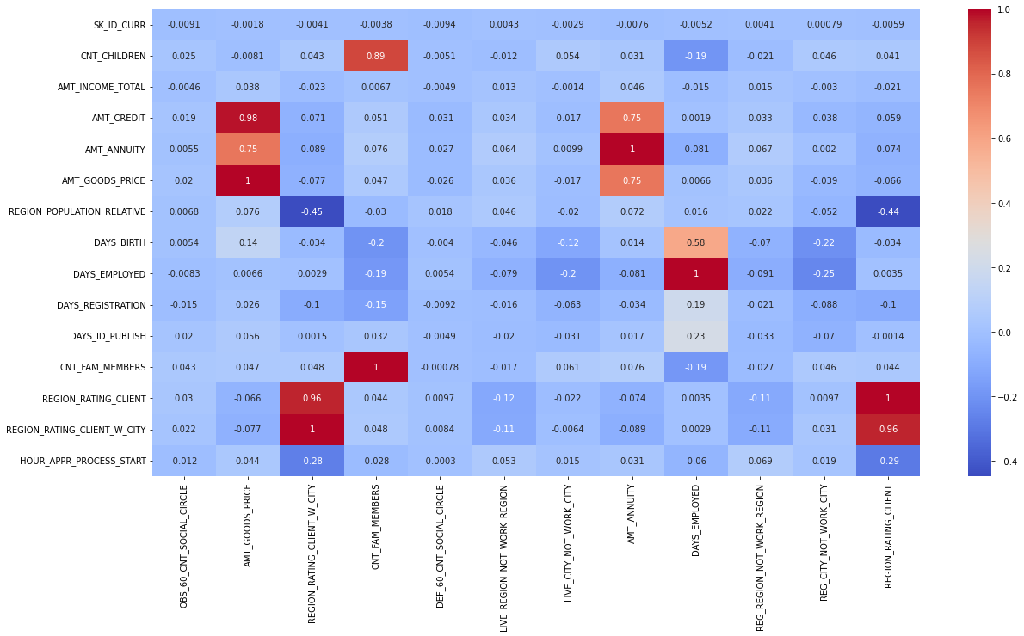
For defaulters

Slide 7
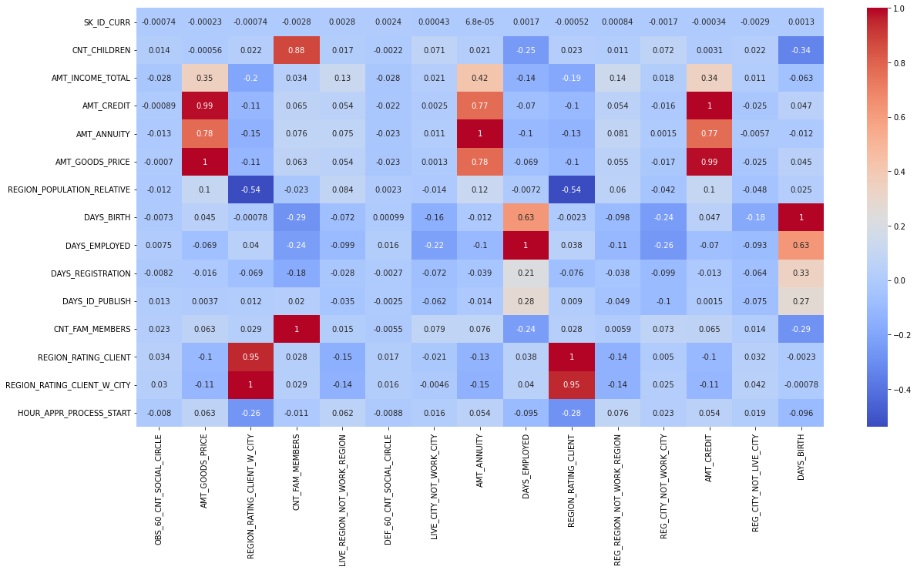
For repayers

Slide 8
Columns with most co_relations
OBS_60_CNT_SOCIAL_CIRCLE | OBS_30_CNT_SOCIAL_CIRCLE | 0.99849
AMT_GOODS_PRICE | AMT_CREDIT | 0.986734
REGION_RATING_CLIENT_W_CITY | REGION_RATING_CLIENT | 0.950842
CNT_FAM_MEMBERS | CNT_CHILDREN | 0.87916
LIVE_REGION_NOT_WORK_REGION | REG_REGION_NOT_WORK_REGION | 0.860627
DEF_60_CNT_SOCIAL_CIRCLE | DEF_30_CNT_SOCIAL_CIRCLE | 0.860517
LIVE_CITY_NOT_WORK_CITY | REG_CITY_NOT_WORK_CITY | 0.825575
AMT_GOODS_PRICE | AMT_ANNUITY | 0.774836
AMT_ANNUITY | AMT_CREDIT | 0.770127
DAYS_EMPLOYED | DAYS_BIRTH | 0.623941
REGION_RATING_CLIENT | REGION_POPULATION_RELATIVE | 0.532877
REGION_RATING_CLIENT_W_CITY | REGION_POPULATION_RELATIVE | 0.531535
REG_REGION_NOT_WORK_REGION | REG_REGION_NOT_LIVE_REGION | 0.450804
REG_CITY_NOT_WORK_CITY | REG_CITY_NOT_LIVE_CITY | 0.440409
REG_CITY_NOT_LIVE_CITY | REG_REGION_NOT_LIVE_REGION | 0.339232

Slide 9
Missing value columns with more than 40% missing values
More than 40% missing data
OWN_CAR_AGE', | 'FLOORSMIN_MODE',
'EXT_SOURCE_1', | 'LANDAREA_MODE',
'APARTMENTS_AVG', | 'LIVINGAPARTMENTS_MODE',
'BASEMENTAREA_AVG', | 'LIVINGAREA_MODE',
'YEARS_BEGINEXPLUATATION_AVG', | 'NONLIVINGAPARTMENTS_MODE',
'YEARS_BUILD_AVG', | 'NONLIVINGAREA_MODE',
'COMMONAREA_AVG', | 'APARTMENTS_MEDI',
'ELEVATORS_AVG', | 'BASEMENTAREA_MEDI',
'ENTRANCES_AVG', | 'YEARS_BEGINEXPLUATATION_MEDI',
'FLOORSMAX_AVG', | 'YEARS_BUILD_MEDI',
'FLOORSMIN_AVG', | 'COMMONAREA_MEDI',
'LANDAREA_AVG', | 'ELEVATORS_MEDI',
'LIVINGAPARTMENTS_AVG', | 'ENTRANCES_MEDI',
'LIVINGAREA_AVG', | 'FLOORSMAX_MEDI',
'NONLIVINGAPARTMENTS_AVG', | 'FLOORSMIN_MEDI',
'NONLIVINGAREA_AVG', | 'LANDAREA_MEDI',
'APARTMENTS_MODE', | 'LIVINGAPARTMENTS_MEDI',
'BASEMENTAREA_MODE', | 'LIVINGAREA_MEDI',
'YEARS_BEGINEXPLUATATION_MODE', | 'NONLIVINGAPARTMENTS_MEDI',
'YEARS_BUILD_MODE', | 'NONLIVINGAREA_MEDI',
'COMMONAREA_MODE', | 'FONDKAPREMONT_MODE',
'ELEVATORS_MODE', | 'HOUSETYPE_MODE',
'ENTRANCES_MODE', | 'TOTALAREA_MODE',
'FLOORSMAX_MODE', | 'WALLSMATERIAL_MODE',
 | 'EME+I27:I50RGENCYSTATE_MODE'
So these columns are not taken for any decision making

Slide 10
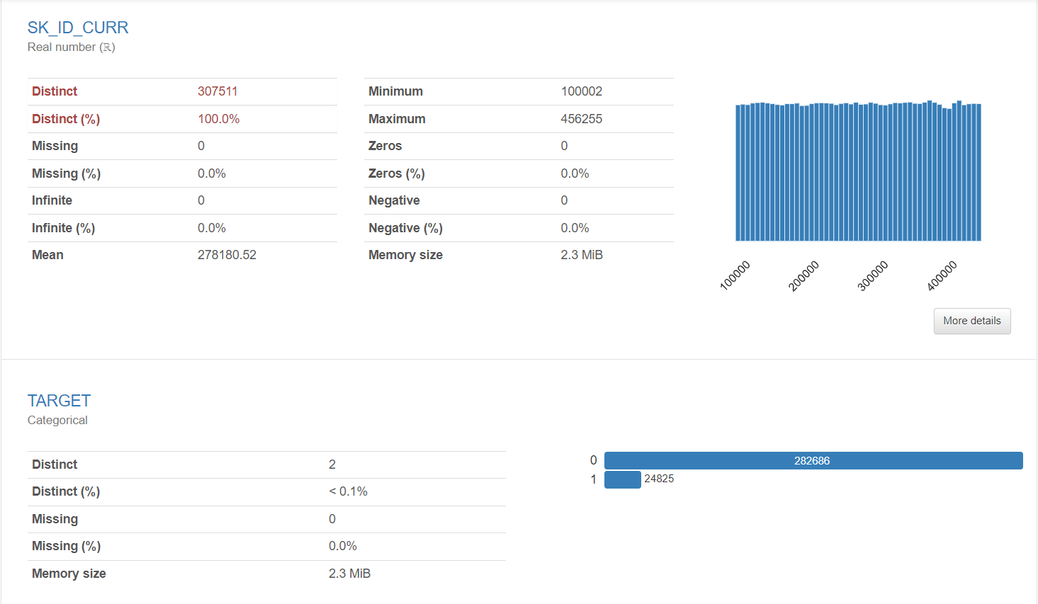

Slide 11
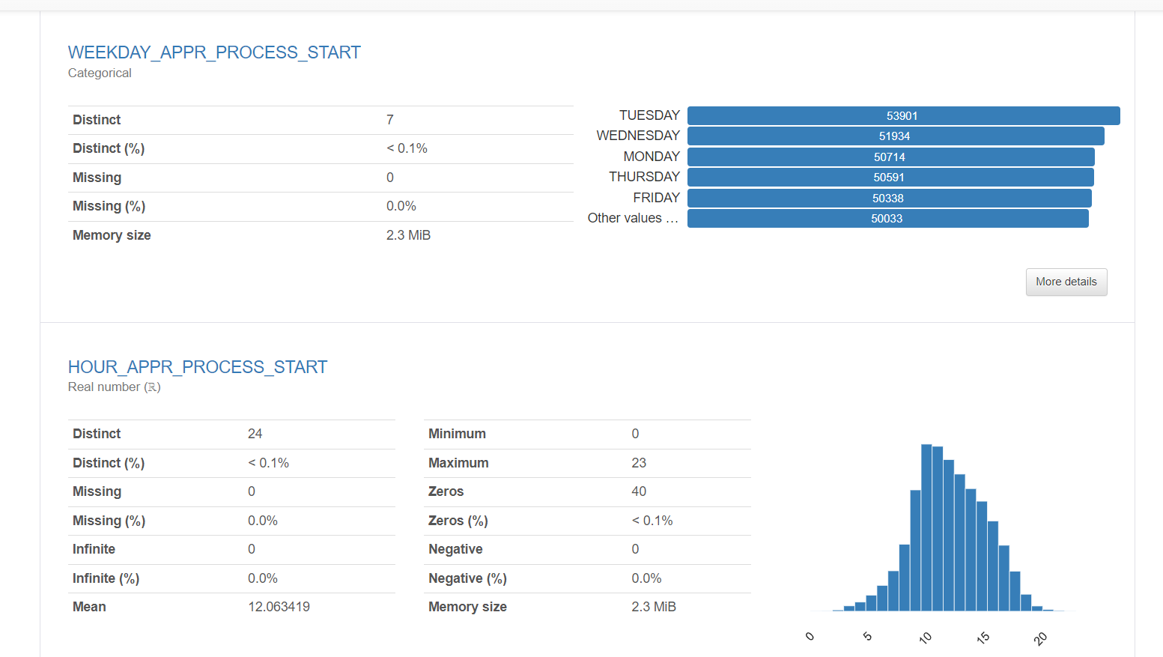
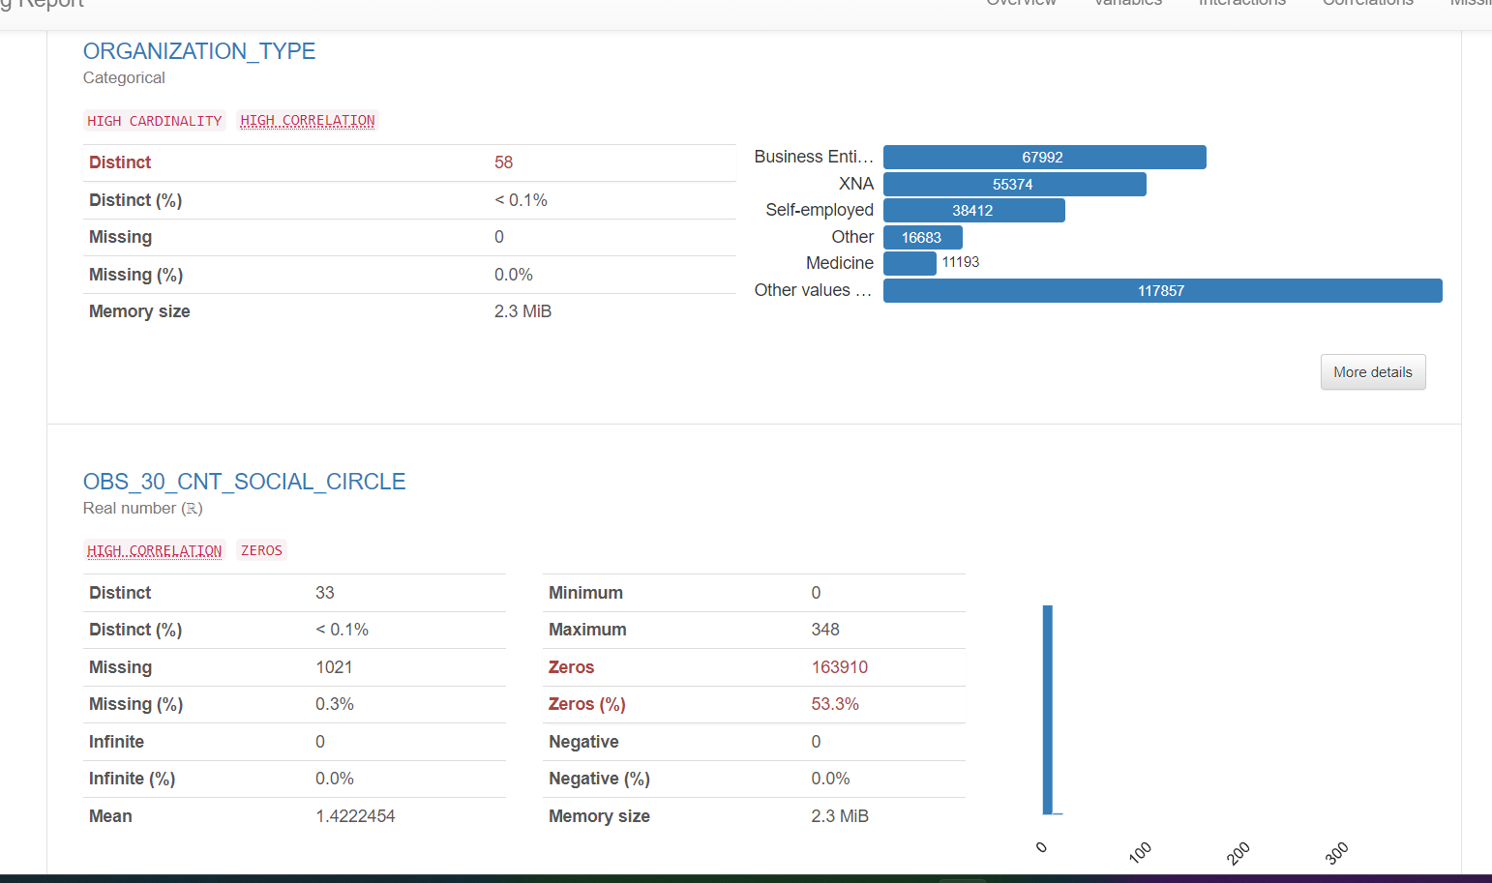
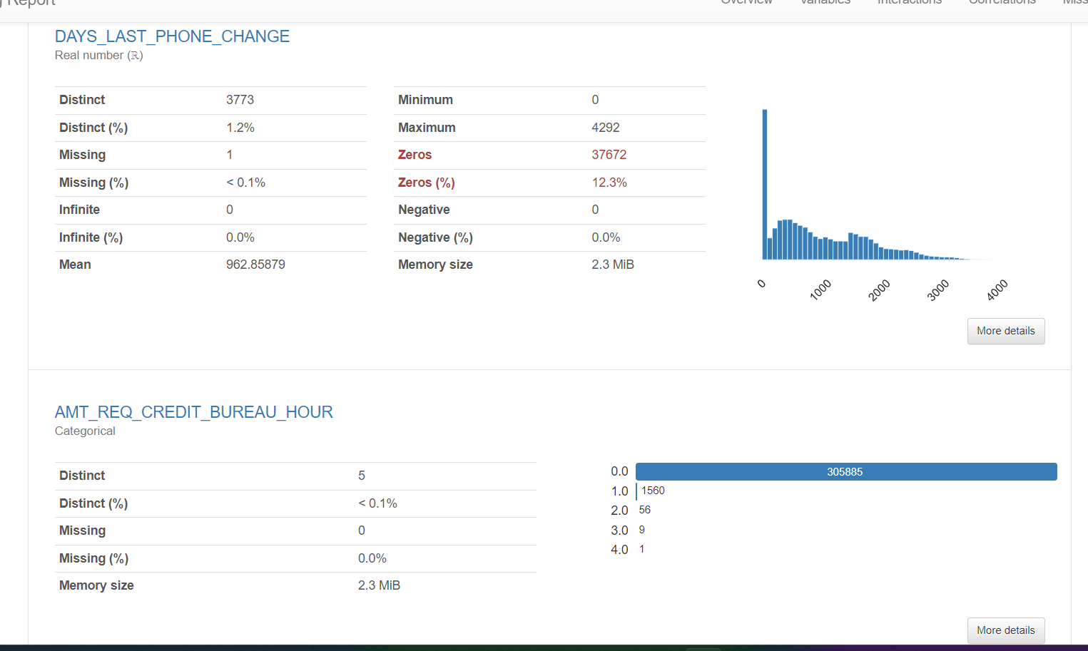
Some Profile alert and overview

Slide 12
Deal with missing values
DAYS_LAST_PHONE_CHANGE 0.000325
CNT_FAM_MEMBERS 0.000650
AMT_ANNUITY 0.003902
AMT_GOODS_PRICE 0.090403
DEF_60_CNT_SOCIAL_CIRCLE 0.332021
OBS_60_CNT_SOCIAL_CIRCLE 0.332021
DEF_30_CNT_SOCIAL_CIRCLE 0.332021
OBS_30_CNT_SOCIAL_CIRCLE 0.332021
NAME_TYPE_SUITE 0.420148
AMT_REQ_CREDIT_BUREAU_QRT 13.501631
AMT_REQ_CREDIT_BUREAU_HOUR 13.501631
AMT_REQ_CREDIT_BUREAU_DAY 13.501631
AMT_REQ_CREDIT_BUREAU_WEEK 13.501631
AMT_REQ_CREDIT_BUREAU_MON 13.501631
AMT_REQ_CREDIT_BUREAU_YEAR 13.501631
OCCUPATION_TYPE 31.345545
Percentage of missing values of different columns, others has no missing values
The numerical columns are filled with mean,median or mode according the statistic of that particular columns. The categorical columns are filled with most_frequent values. And all the columns are filled.

Slide 13
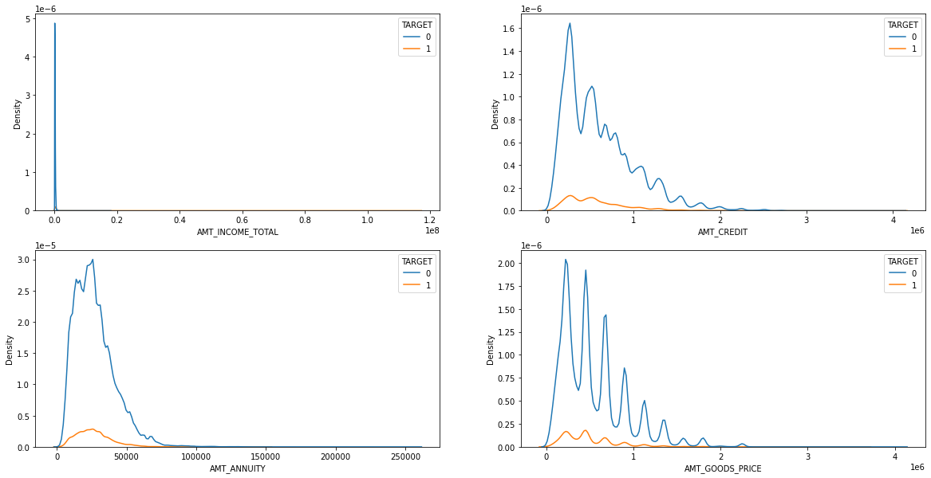
Density plots for different columns

Slide 14
Insights from previous univariate analysis
1. Most of the repayers are in the range in 1 milloin of income.
2. The price of the goods(AMT_GOODS_PRICE) are mostly 0 - 1 million
3. And so the amount credit(AMT_CREDIT ) is also mostly 0 - 1 million.
4. Most of the customurs are paying annuity(AMT_ANNUITY) between 0 - 50000.

Slide 15
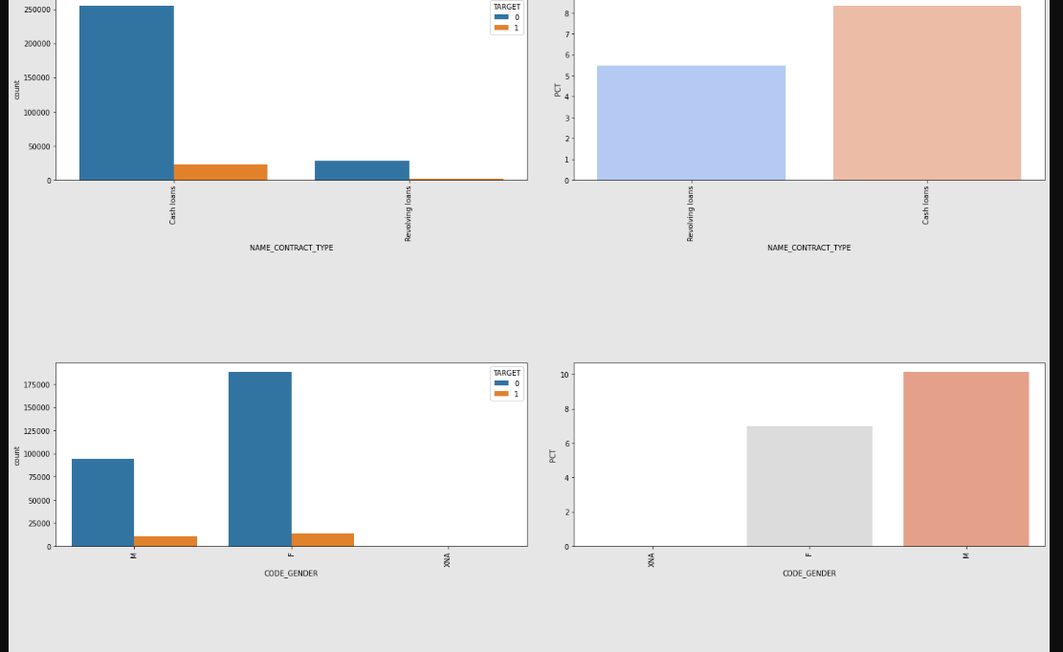
Insights from the different columns
LOAN_TYPE :-
1. The number of cash loan taker is higher than the Revolving loan taker.
And also the nomber of defaulter is high in case of cash loan taker
CODE_GENDER :-
2. Female loan takers are higher and also the percentage of female [8%] defaulter is
less than male[10%] loan takers.

Slide 16
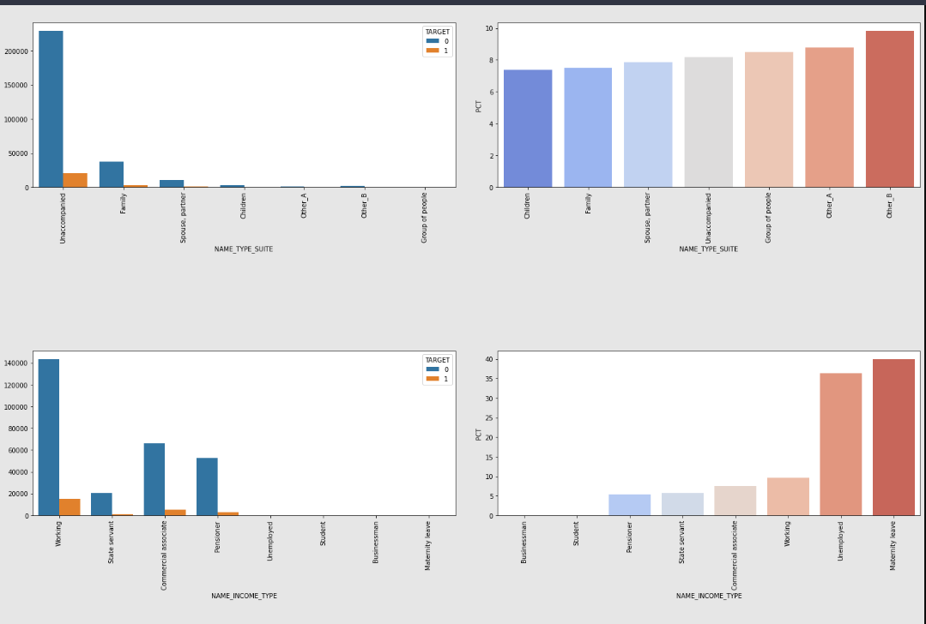
Insights from the different columns
NAME_TYPE_SUIT :-
3. MOst of the time unacompanied people are taking loans and the default rate is 8.5%
which is still ok.
NAME_INCOME_TYPE :-
4. Most of the loans are given to the 'working' profesionals followed by 'commercial associate
and 'pentioners' and also their defaulter rate is also low.

Slide 17
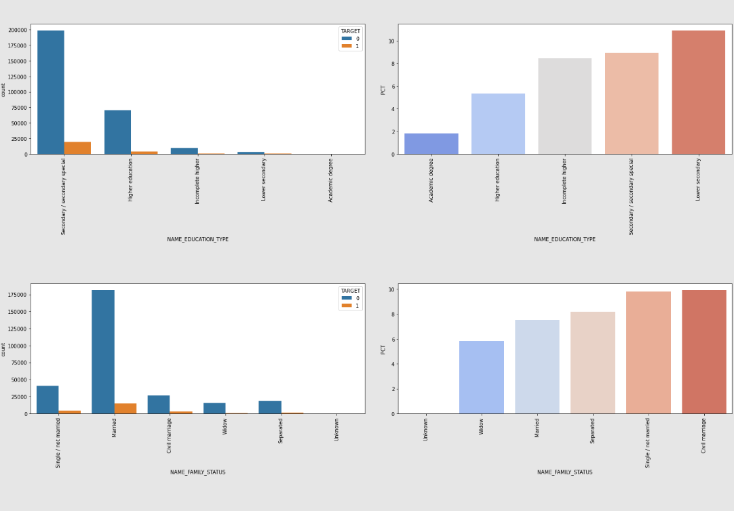
Insights from the different columns
NAME_EDUCATION_TYPE :-
5. Most of the loans are given for the secondary and higher eduction. The default rate for higher education [5%] is less than secondary education loan [9%]. So higher EDUCATIONIS SAFER TO give loans.
NAME_FAMILY_STATUS :-
6. Most of the loans are given to the married people and also their defaulter rate is less than 8% , which is quite acceptable.

Slide 18
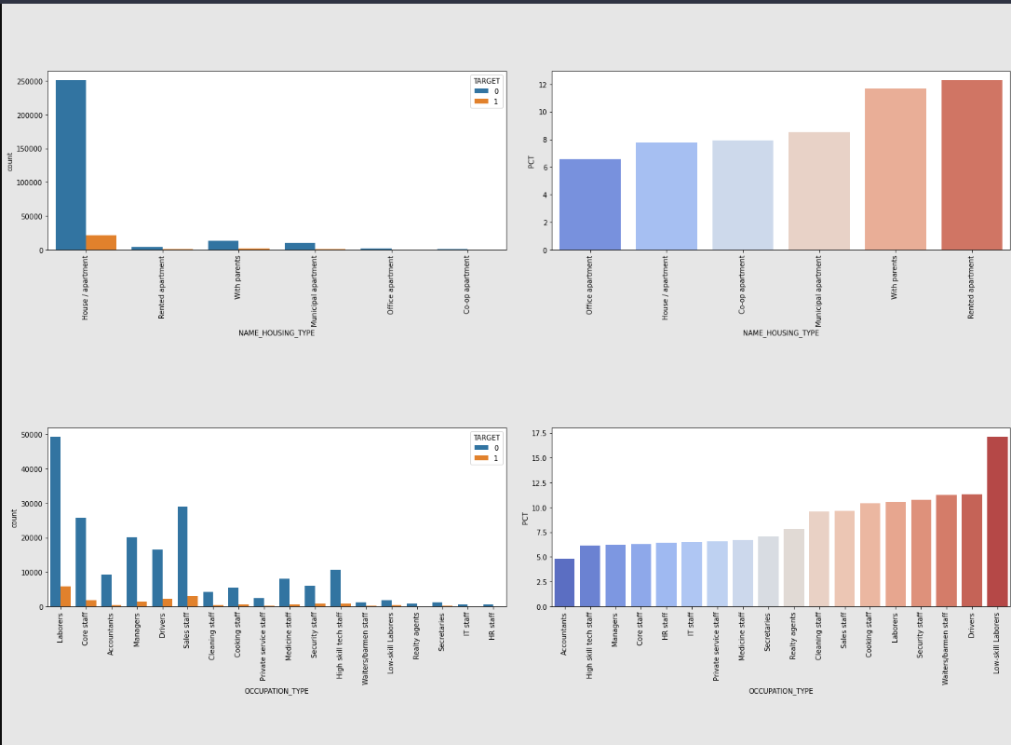
Insights from the different columns
NAME_HOUSING_TYPE :-
7. People havbing own house are safer to give the loan with the defaulter rate of 8%.
OCCUPATION_TYPE :-
8. Low-skilled laboureres and drivers are highest defaulter. Accountants are less defaulters.Number of Labours, core-stuff, manegers are high and also their default rate arein safer side.

Slide 19
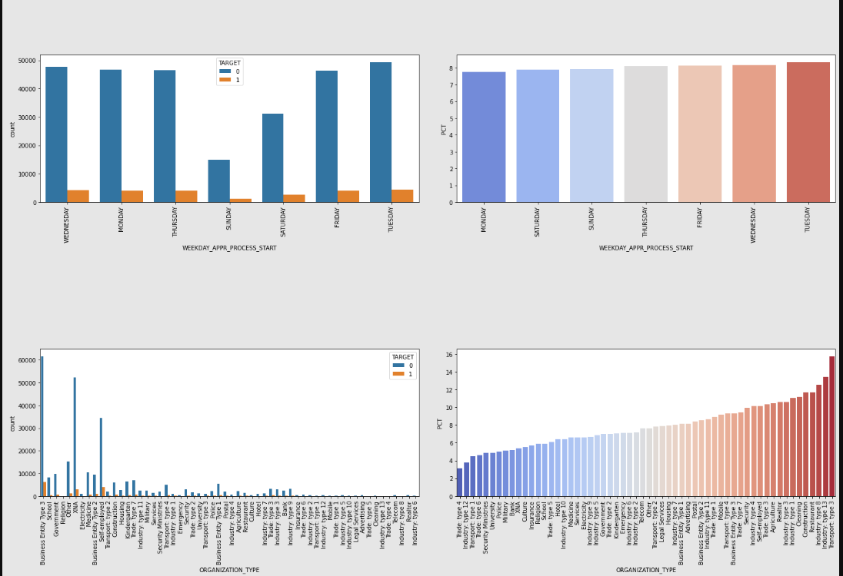
Insights from the different columns
WEEKDAY_APPRVAL_PROCESS_START :-
9. This data will be make not that much sence so we are ignoring this column.
ORGANISTAION_TYPE :-
10. Highest defaulter - Transport type -3 [nuber is very less] XNA are the safest as their number is high and default rate is also less. Bussiness entity 3 , self employed and other also in good number and comperatively safe to give loan.

Slide 20
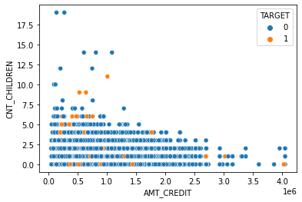
Scatter plots between columns (bivariate analysis)

Slide 21
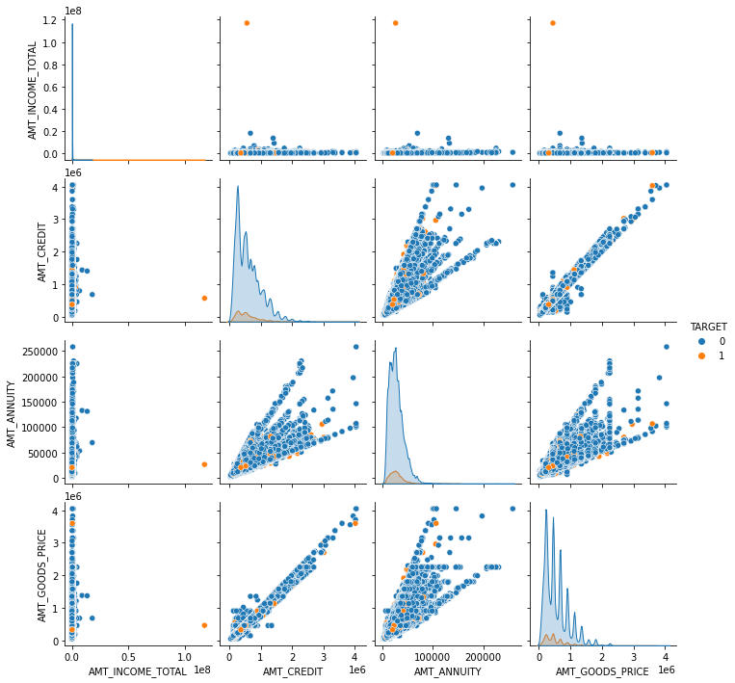

Slide 22
Insights from bi variate analysis
1. AMT_CREDIT and AMT_GOODS_PRICE are nearly co-related. If the amount credit increases the number
of defaulter decreases.
2. The people with less annual income (1 milion) are more likely to take loans , out of which
who are given loans less than 1.5 million are likely to be defaulter.
3. Most number of loans are given to the people who have a annuity amount of 100k or less than that.

Slide 23
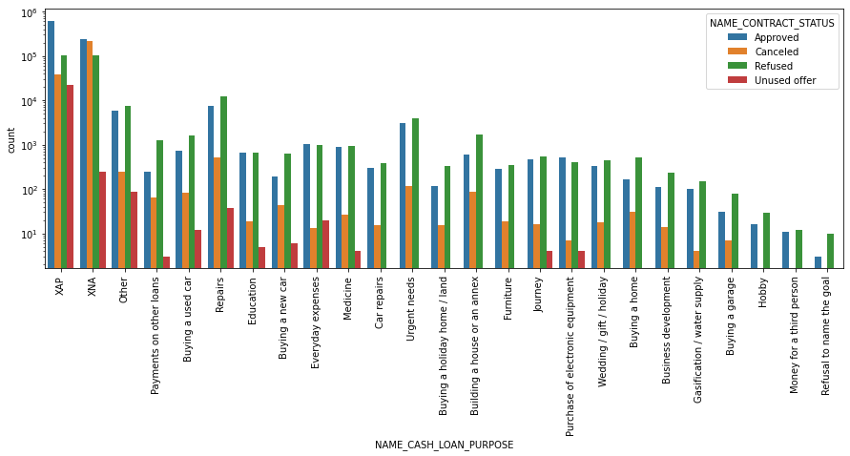
From the previous application data

Slide 24
It is seen that most of the applications was coming from the XNA and XNP reason, Those applications are most approved and also more refused than the other causes.

Slide 25
Analysis and conclusion
This dataset was a huge to analyze, but many information were extracted from the dataset. Many characteristic about the defaulters and repayers like, who are safer to give loans, who are not safer to give loans. And many more inshights are given.

